Slide 1
UMD DATA605 - Big Data Systems Git
Data Pipelines
Dr. GP Saggese
gsaggese@umd.edu
with thanks to Prof.
Alan Sussman
Amol Deshpande

Slide 2
UMD DATA605 - Big Data Systems Git
Data Pipelines

Slide 3

Bash / Linux: Resources
Command line
https://ubuntu.com/tutorials/command-line-for-beginners
find, xargs, chmod, chown
symbolic and hard links
How Linux works
Process
File ownership and permission
Virtual memory
How to administer a Linux box as root
Mastery
https://linuxcommand.org/tlcl.php

Slide 4

Git: Resources
Concepts in the slides
Tutorial: tutorial_git
We will use Git during the project
Mastery: Pro Git (free)
Web resources:
dangitgit.com (aka Oh Sh*t, Git!?!)

Slide 5
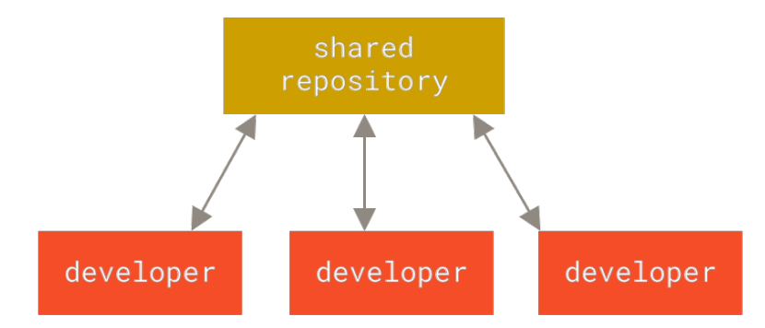
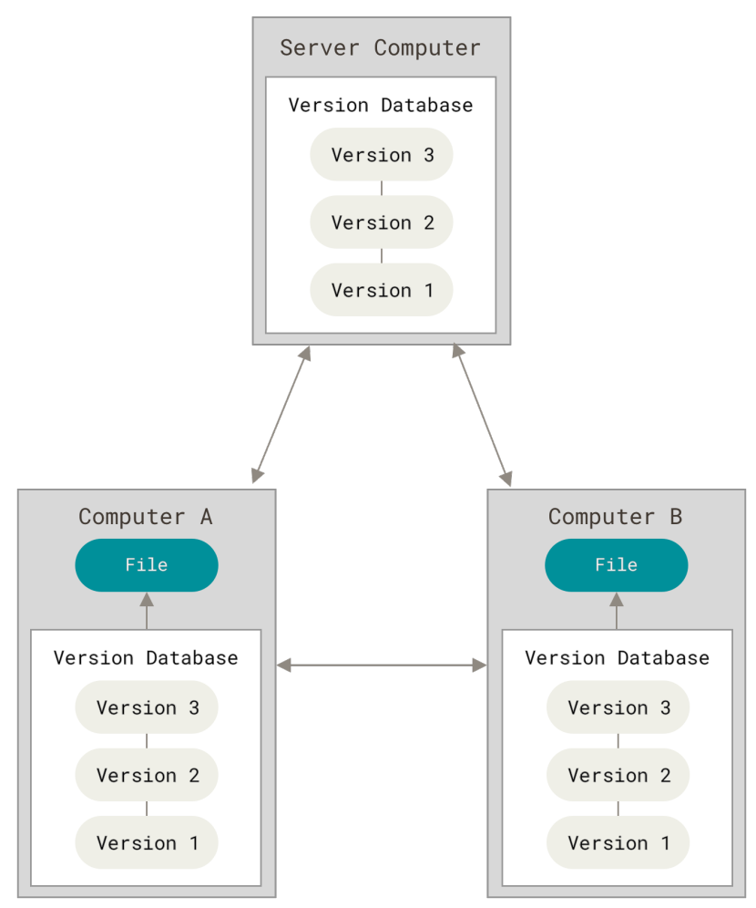
Version Control Systems
A VCS is a system that allows to:
Record changes to files
Recall specific versions later (like a time-machine)
Compare changes over time
Track who changed what and when
Simplest “VCS”
Make a copy of a dir and add `_v1` (bad) or add a timestamp `_20220101` (better)
It kind of works for one person, but doesn’t scale
Centralized VCS
E.g., Perforce, Subversion
There is a server storing the code, clients that connect to it
If the server is down, nobody can work
Distributed VCS
E.g., Git, Mercurial, Bazaar, Dart
Each client has the entire history of the repo locally
Each client is a repo server

Slide 6
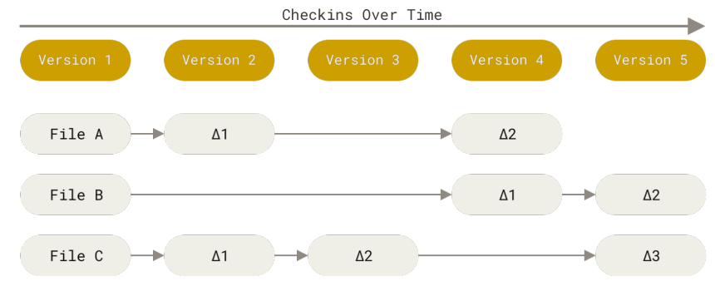
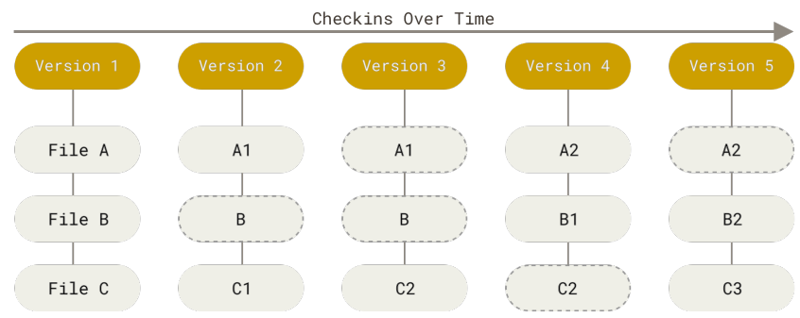
VCS: How to Track Data
There is a directory with project files inside
How do you track changes?
Delta-based VCS
E.g., Subversion
Store the data in terms of patches (changes of files over time)
Can reconstruct the state of the repo by applying the patches
Stream of snapshots VCS
E.g., git
Data in terms of snapshots of a filesystem
Take a “picture” of what files look like
Store reference to the snapshots
Save link to previous identical files

Slide 7
Git
Almost everything is local for Git
History is stored locally
Diff-ing is done locally
You can commit to your local copy
Upload changes when there is network connection
Almost everything is undoable in Git
No data corruption
Everything is checksummed
Nothing can be lost
As long as you commit
Ideally, besides “git hell”
You need to know how to do it
Git is like a mini file-system / key-value store with a VCS built on top
Actually this is exactly true
Two layers: “porcelain” and “plumbing”

Slide 8
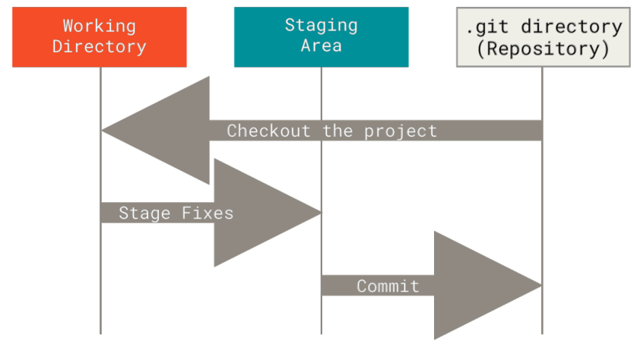
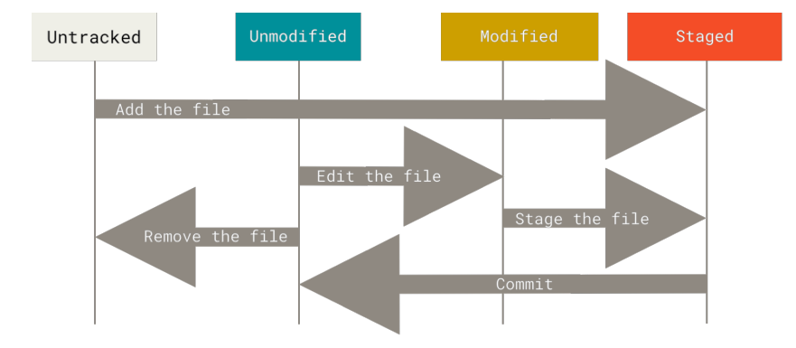
States of a File in Git
There are 3 main sections of a Git project:
Working tree (aka checkout)
Version of the code placed on the filesystem for the user to use and modify
Staging area (aka cache, index)
A file in `.git` that stores information about the next commit
Git directory (aka `.git`)
Store metadata and objects (like a DB)
It is the repo itself with all history
When you clone, you get the `.git` of the project
Each file can be in 4 states from Git point-of-view
Untracked: files that are not under Git version control
Modified: you have changed the file, but not committed to DB yet
Staged: you have marked a modified file in its current version to go into your next commit snapshot
Committed: data is safely stored in your local DB

Slide 9
Git Tutorial
Git tutorial

Slide 10
Git: Daily Use
Check out the project (`git clone`) or start from scratch (`git init`)
Only once per project or per client
Daily routine
Modify files in working tree (`vi ...`)
Add files (`git add ...`)
Stage changes for the next commit (`git add -u ...`)
Commit changes to `.git` (`git commit`)
Use a branch to group commits together
Isolate your code from changes in master
Merge `master` into your branch
Isolate master from your changes
PR to get the code reviewed
Merge PR into upstream

Slide 11
Git Remote
Remote repos are versions of the project hosted on Internet or on a “remote” file system
To collaborate you need to manage remote repos
Push / pull changes
You can have multiple repos with different policies
E.g., read-only, read-write
`git remote -v`: show what are the remotes
`git fetch`: pull from the remote repo all the data (e.g., branches, commits) that you don’t have locally
`git pull`: a short hand from `git fetch origin` + `git merge --rebase`
`git push <REMOTE> <BRANCH>`
E.g., `git push origin master`
If somebody pushed to the remote, you can’t push your changes right away, but you need to:
Fetch the changes
Merge changes in your client
Resolve conflicts, if needed
(Test project sanity, e.g., by unit tests)
Push it to the remote

Slide 12
Git Tagging
Git allows to mark specific points in history with a tag
E.g., release points
You can check out a tag
You get in detached HEAD state
If you commit your change won’t be added to the tag or to the branch
The commit will be unreachable (only by the commit hash)

Slide 13
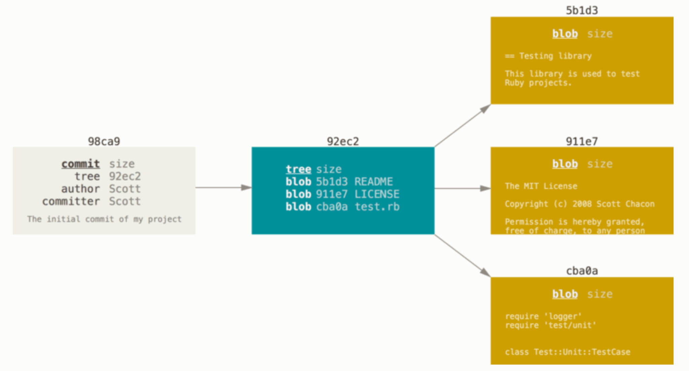
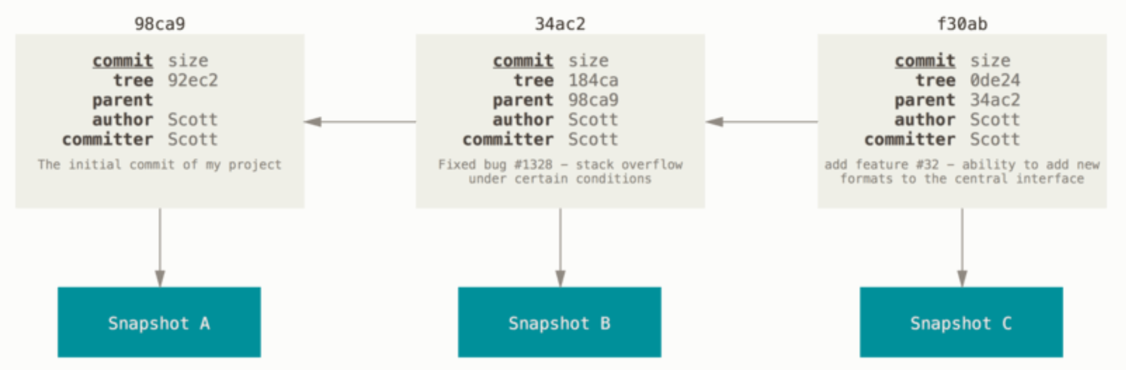
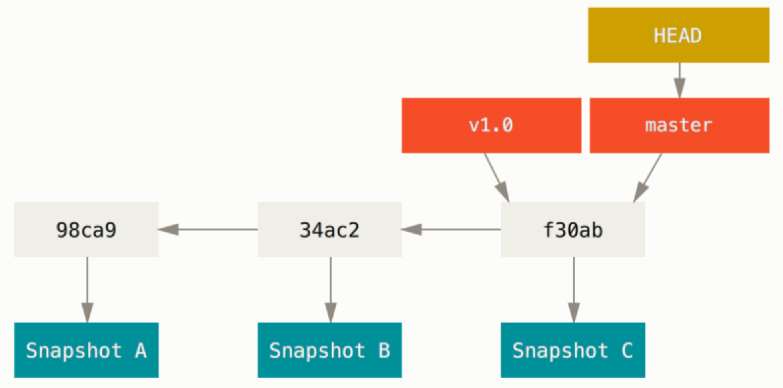
Git Internals
You can understand Git only if you understand the data model
Git is a key-value store with a VCS user interface on top of it
Key = hash of a file
Value = content of a file
Git objects
Blobs: content of files
Trees: represent directories and mapping between files and blobs
Commits: stores pointer to the hash and metadata
Tags
Refs:
Easy: Understanding Git — Data Model
Hard-core: Git internals
Commit tree
Commit parents
Commit history of a branch

Slide 14
Git Branching
Branching = diverging from the main line of development
Why?
Work without messing the rest of the code
Work without being affected by changes in the main branch
Once you are done with working in the branch, merge code upstream
Git branching is lightweight
It’s instantaneous
A branch is just a pointer to a commit
Git doesn’t store data as difference of files, but as a series of snapshot
Git branching workflows branch and merge often
Even multiple times a day

Slide 15
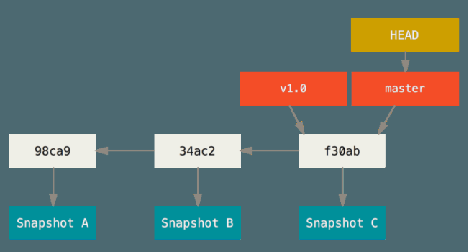
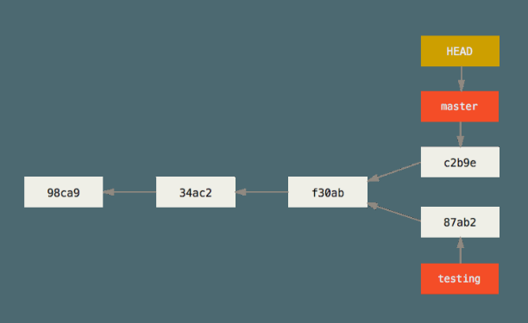
Git Branching
`master` (or `main`) is just a normal branch
`master` is a pointer to the last commit
As you commit the pointer moves forward
`HEAD`
Pointer to the local branch you are on
E.g., `master`, `testing`
`git branch testing`
Create a new pointer `testing`
Point to the commit you are on
Can be moved around
Divergent history
When work progresses in two branches

Slide 16
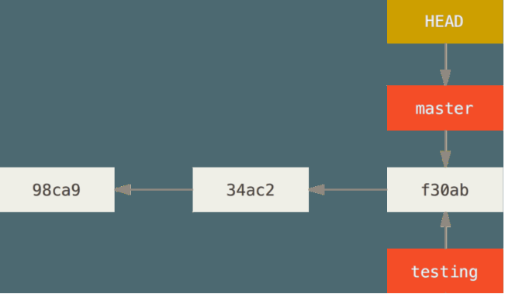
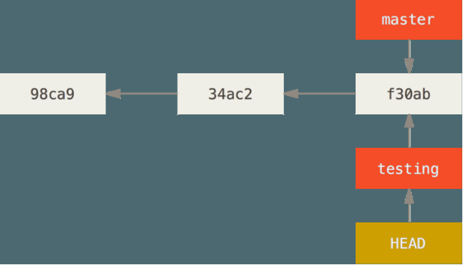
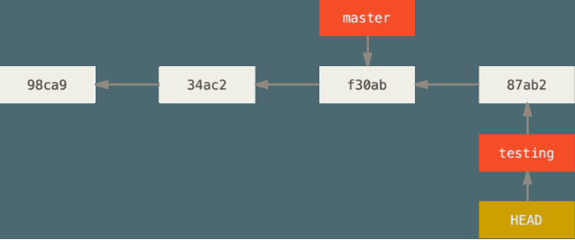
Git Checkout
`git checkout` switches branch
Move `HEAD` to the new branch
Change the files in the working dir to match the state corresponding to the branch pointer
`git checkout testing`
Then you can keep working by committing on `testing`

Slide 17
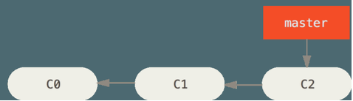
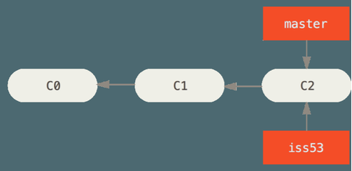
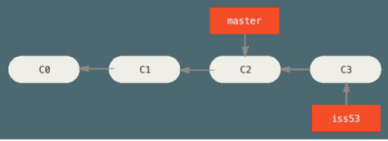
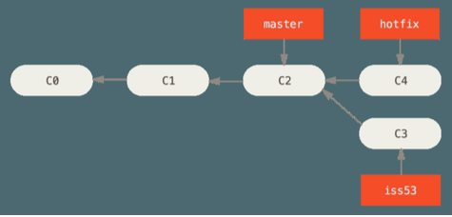
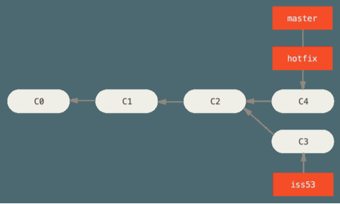
Git Branching and Merging
Start from a project with some commits
Branch to work a new feature “Issue 53”
> git checkout -b iss53
work ... work ... work
> git commit
Need a hot-fix to master
> git checkout master
> git checkout -b hotfix
fix ... fix ... fix
> git commit -am “Hot fix”
> git checkout master
> git merge hotfix
Fast forward
There is a divergent history between `master` and `iss53`

Slide 18
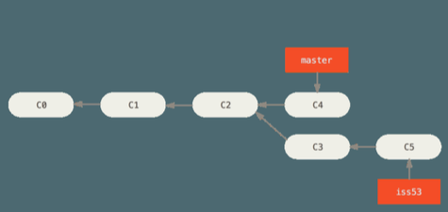
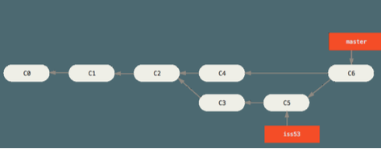
Git Branching and Merging
> git checkout iss53
work ... work ... work
The branch keeps diverging
At some point you are done with iss53
You want to merge your work back to master
Go to the target branch
> git checkout master
> git merge iss53
Git can’t fast forward
Git creates a new snapshot with the 3-way “merge commit” (commit with more than one parent)
Delete the branch
> git branch -d iss53

Slide 19

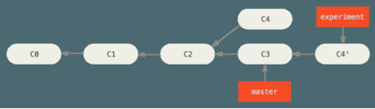
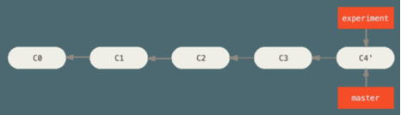
Fast Forward Merge
Merge a commit X with a commit Y that can be reached by following the history of commit X
There is not divergent history to merge
E.g., C4’ is reachable from C3
> git checkout master
> git merge experiment
Git simply moves the branch pointer forward from X to Y

Slide 20
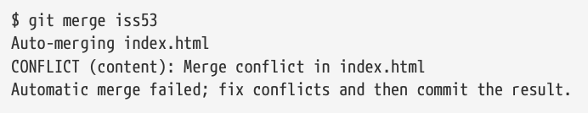
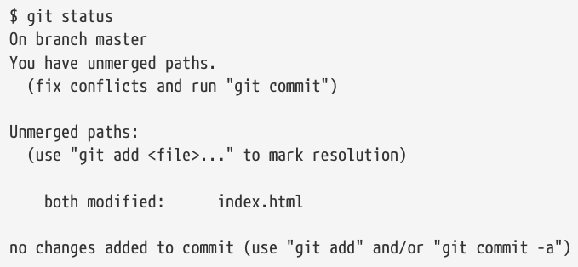
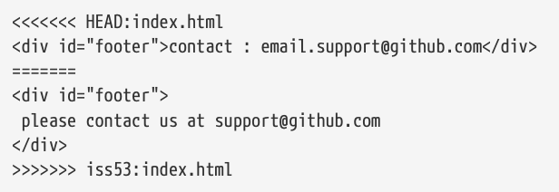
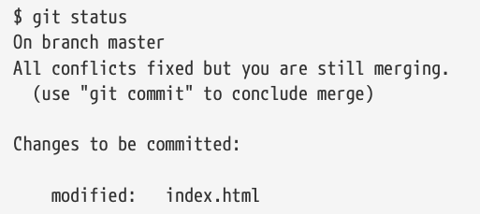
Merging Conflicts
Sometimes Git can’t merge, e.g.,
The same file has been modified by both branches
One file was modified by one branch and deleted by another
Git
Does not create a merge commit
Pauses to let you resolve the conflict
Adds conflict resolution markers
User merges manually
Edit the files `git mergetool`
`git add` to mark as resolved
`git commit`
Use PyCharm

Slide 21
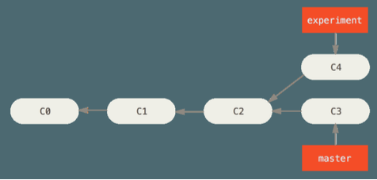
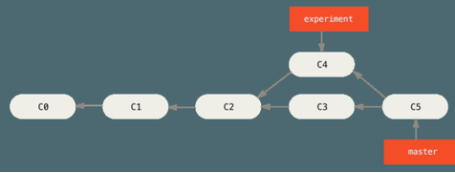
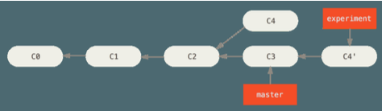
Git Rebasing
In Git there are two ways of merging divergent history
E.g., master and experiment
Have a common ancestor C2
Merge
Create a new snapshot C5 and commit
Go to the target branch
> git checkout master
> git merge experiment
Rebase
Go to the branch to rebase
> git checkout experiment
> git rebase master
In words rebasing is like:
Get all the changes committed in the branch (C4) where we are on (experiment) since the common ancestor (C2)
Sync to the branch that we are rebasing onto (master at C3)
Apply the changes C4'
Only the branch where we are is affected

Slide 22
Uses of Rebase
Rebasing makes for a cleaner history
The history looks like all the work happened in series
Although in reality it happened in parallel to the development in `master`
Rebasing to contribute to a project
You are contributing to a project that you don't maintain
You work on your branch
When you are ready to integrate your work, rebase your work onto `origin/master`
The maintainer
does not have to do any integration work
does just a fast forward or a clean apply

Slide 23
Golden Rule of Rebasing
Rebasing means abandoning existing commits and creating new ones that are similar but different
The problem is:
1. You push your commits somewhere
2. Others pull your commits down and base their work on them
3. You rewrite those commits with `git rebase` and push them again with `git push --force`
4. Your collaborators have to re-merge their work
Solution
Strict version: "Do not rebase commits that exist outside your repository"
Loose version: “It’s ok to rebase your branch even if you pushed to a server, as long as you are the only one to use it”

Slide 24
Rebase vs Merge
Rebase and merge are depend on the interpretation of the repository commit history
What does the commit history of a repo mean?
a) A record of what actually happened
History should not be tampered with
What if there is a series of messy merge commits?
This is how it happened
The repo should preserve this
Use `git merge`
b) The story of how a project should have been made
You would not publish a book as a sequence of drafts and correction, but rather the final version
Tell the history in the way that is best for future readers
Use `git rebase` and filter-branch
Best of the merge-vs-rebase approaches
Rebase changes you've made in your local repo but haven't pushed yet `git pull --rebase` to clean up your history
Merge to master to preserve the history of how something was built
In practice squash-and-merge branches

Slide 25
Remote branches
Remote branches are pointers to branches in remote repos
> git remote -v
origin git@github.com:gpsaggese/umd_data605.git (fetch)
origin git@github.com:gpsaggese/umd_data605.git (push)
Tracking branches
Local references representing the state of the remote repo
E.g., `master` tracks `origin/master`
Can’t change the remote branch (e.g., `origin/master`)
Can change tracking branch (e.g., `master`)
Git updates them when you do `git fetch origin` (or `git pull`)
To share code in a local branch you need to push them to a remote
> git push origin serverfix
To work on it
> git checkout -b serverfix origin/serverfix

Slide 26
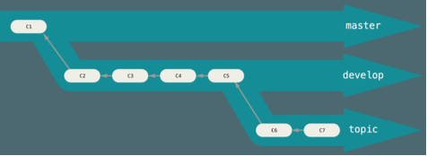
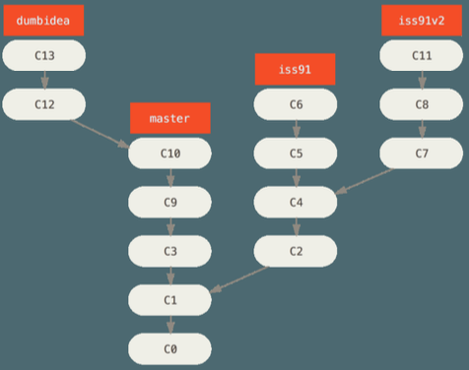
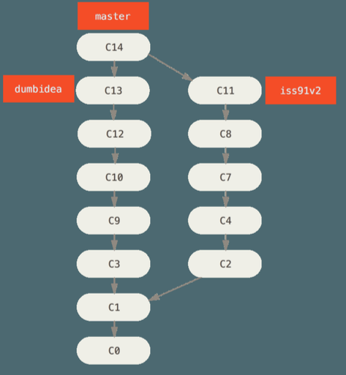
Git Workflows
Workflows
= ways of working and collaborating using Git
Long-running branches
Branches at different level of stabilities, that are always open
1. `master` is always ready to be released
2. `develop` to develop in
3. Topic / feature branches
When branches are "stable enough" they are merged up
Topic branches
Short-lived branches for a single feature
E.g., `hotfix`, `wip-XYZ`
Easy to review
Silo-ed from the rest
This is typical of Git since other VCS support for branches is not good enough

Slide 27
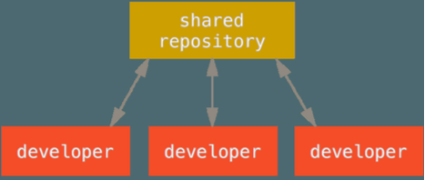
Centralized Workflow
Centralized workflow in centralized VCS
Developers:
Check out the code from the central repo on their computer
Modify the code locally
Push it back to the central hub (assuming no conflicts with latest copy, otherwise they need to merge)
Centralized workflow in Git
Developers:
Have push (i.e., write) access to the central repo
Need to fetch and then merge
Cannot push code that will overwrite each other code (only fast-forward changes)

Slide 28
Forking Workflows
Typically devs don't have permissions to update directly branches on a project
Read-write for contributors
Read-only for anybody else
The solution is based on “forking” a repo
External contributors
Clone the repo and create a branch with the work
Create a writable fork of the project
Push branches to fork
Prepare a PR with their work
Project maintainer
Reviews PRs
Accepts PRs
Integrates PRs

Slide 29
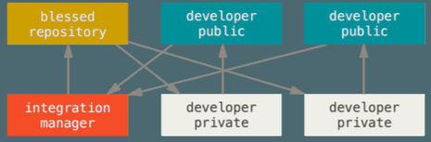
Integration-Manager Workflow
This is the classical model for open-source development
E.g., Linux, GitHub fork
Each dev has:
Write access to their own public repo
Read access to everyone else's public repo
1. One repo is the "official" project
Only the project maintainer pushes to the public repo
2. Each contributor:
Forks the project into a private copy
Makes changes
Pushes changes to his own public copy
Sends email to maintainer asking to pull changes (pull request)
3. The maintainer:
Adds contributor repo as a remote
Merges the changes into a local branch
Tests changes locally
Pushes branch to official repo

Slide 30
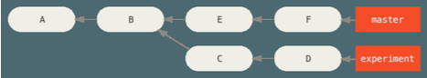
Git log
`git log` reports info about commits
`refs` are references to
HEAD (next commit)
origin/master (remote branch)
experiment (local branch)
d921970 (commit)
^ after a reference resolves to the parent of that commit
HEAD^ = commit before HEAD, i.e., last commit
^2 means ^^
A merge commit has multiple parents
Double-dot notation
1..2 range of commits that are reachable from 2 but not from 1
git log master..experiment -> D,C
git log experiment..master -> F,E
Triple-dot notation
1...2 commits that are reachable from either of the two differences but not from both
git log master...experiment -> F,E,D,C

Slide 31
Advanced Git
stashing
Copy state of your working dir (e.g., modified and staged files), save it in a stack, to apply later
cherry-picking
Rebase for a single commit
rerere
= “Reuse Recorded Resolution”
Git caches how to solve certain conflicts
tagging
Give a name to a specific commit (e.g., v1.3)
submodules / subtrees
Project including other Git projects
bisect
Sometimes a bug shows up at top of tree
You don't know at which revision it started manifesting
You have a script that returns 0 if the project is good and non-0 if the project is bad
`git bisect` can find the revision at which the script goes from good to bad
filter-branch
Rewrite repo history in some script-able way
E.g., change your email, remove a file (with passwords or large file)
Checks out each version, runs the command, commits the result
hooks
Run scripts before each commit, merging, ...

Slide 32
GitHub
GitHub acquired by MSFT for $7.5b
GitHub: largest host for Git repos
Git hosting (many open source projects)
PRs, forks
Issue tracking
Code review
Collaboration
Wiki
Actions (CI / CD)
“Forking a project”
In open-source communities
It had a negative connotation
Take a project, modify it, and make it a competing project
In GitHub parlance
Forking means making a copy to a project so that you can contribute it even if you don’t have push / write access

Slide 33
UMD DATA605 - Big Data Systems Git
Data Pipelines

Slide 34
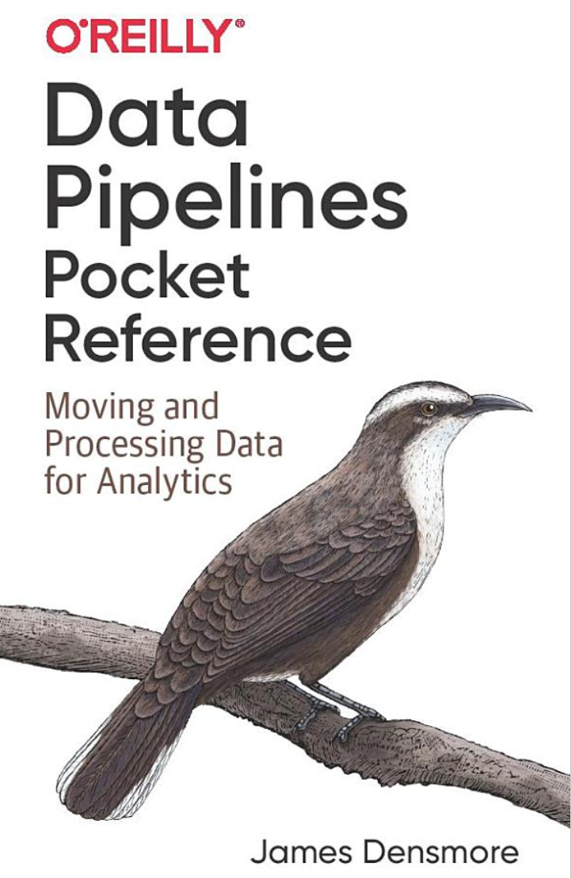
Data Pipelines - Resources
Concepts in the slides
Class project
Mastery:
Data Pipelines Pocket Reference: Moving and Processing Data for Analytics

Slide 35
Data as a Product
Many services today sell data (e.g., Google, Facebook, Amazon, Netflix)
Data products, e.g.,
A recommendation engine
Personalized search engine
Sentiment analysis on user-generated reviews
Services are typically powered by machine learning
Many steps are required
Data ingestion
Data pre-processing
Cleaning, tokenization, feature computations
Model training
Model deployment
MLOps
Monitor model
Is it working?
Is it getting slower?
Are performance getting worse?
Feedback from deployment
E.g., recommendations vs what users bought
Ingest data back for future versions of the model

Slide 36
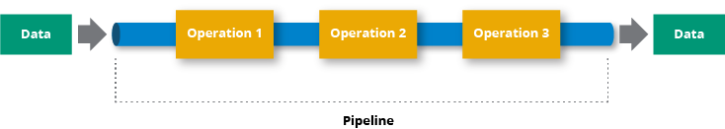
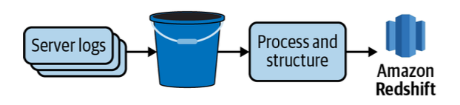
Data Pipelines
“Data is the new oil”
Data needs to be:
collected
pre-processed / cleaned
validated
processed
combined
Data pipelines
Processes that move and transform data
Goal: derive new value through analytics, reporting, machine learning
Data ingestion
Simplest data pipeline
Extract data (e.g., from REST API)
Load data into DB (e.g., SQL table)

Slide 37
Roles in Building Data Pipelines
Data engineers
Build and maintain data pipelines
Tools:
Python / Java / Go / No-code
SQL / NoSQL stores
Hadoop / MapReduce / Spark
Cloud computing
Data scientists
Build predictive models
Tools:
Python / R / Julia
Hadoop / MapReduce / Spark
Cloud computing
Data analysts
E.g., marketing, MBAs, sales, ...
Build metrics and dashboards
Tools:
Excel spreadsheets
GUI (e.g., Tableaux)
Problems in practice
Who is responsible for the data?
Issues with scaling
Build-vs-buy
Which tools?
Open-source vs proprietary
Architecture
Who is in charge of it?
Conventions
Documented
Getting stuff done
Done is better than perfect
Service level agreement
Talk to stakeholders on a regular basis

Slide 38
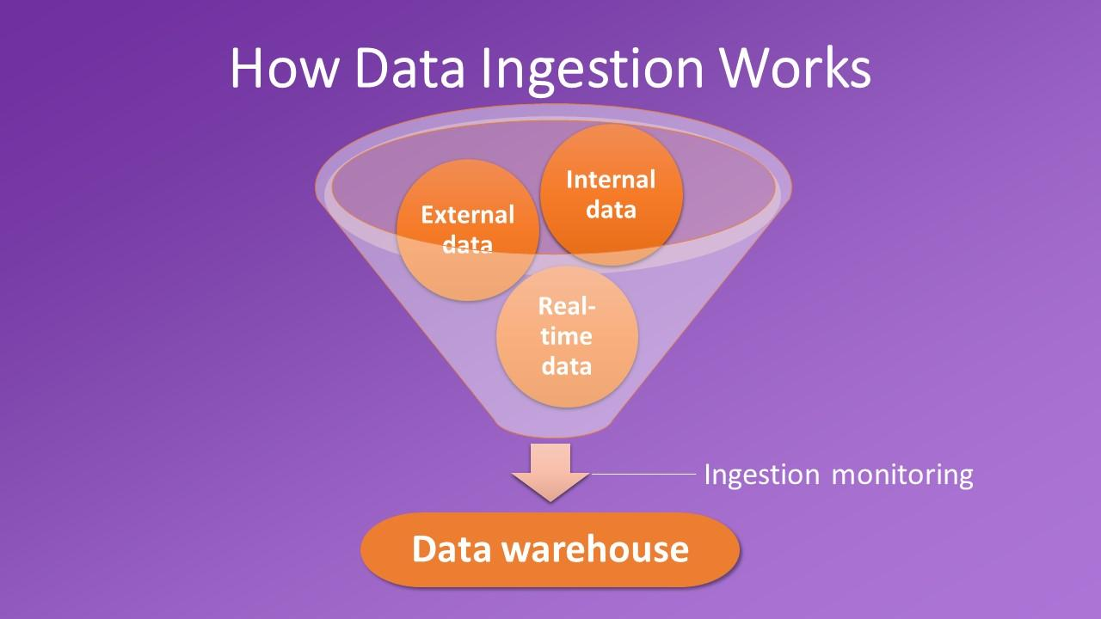
Data Ingestion
Data ingestion
= extract data from one source and load it into another
Data sources
DBs
E.g., Postgres, MongoDB
REST API (abstraction on top of DBs)
Network file system / cloud
E.g., CSV files, Parquet files
Data warehouses
Data lakes
Source ownership
An organization can use 10-100s of data sources
Internal
E.g., Postgres DB storing shopping carts
3rd-parties
E.g., Google analytics tracking website usage

Slide 39
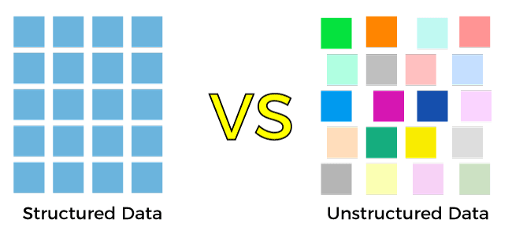
Structure in Data (or Lack Thereof)
Structured data: there is a schema
Relational DB
CSV
DataFrame
Parquet
Semi-structured: different subsets of data have different schema
Logs
HTML pages
XML
Nested JSON
NoSQL data
Unstructured: no schema
Text
Pictures
Blobs

Slide 40
Data Cleaning
Data cleanliness
Quality of source data varies greatly
Typically messy
Duplicated records
Incomplete or missing records
Inconsistent formats
E.g., phone with / without dashes
Mislabeled or unlabeled data
When to clean it?
As soon as possible
In different stages
As late as possible
ETL vs ELT vs EtLT
Mantras
Hope for the best, assume the worst
Validate data early and often
Don’t trust anything
Be defensive

Slide 41
OLAP vs OLTP Workloads
There are two classes of data workloads
OLAP
On-Line Analytical Processing
Perform multi-dimensional analysis at high speeds on large volumes of data
Few large read or write transactions
E.g., data mining, business intelligence
OLTP
On-Line Transactional Processing
Execute large numbers of transactions by a large number of people in real-time
Lots of concurrent small read / write transactions
E.g., online banking, e-commerce, travel reservations

Slide 42
Data Volumes
High-volume vs low-volume
Lots of small reads / writes
A few large reads / writes
One-shot vs streaming
Other challenges
API rate limits / throttling
Connection time-outs
Slow downloads

Slide 43
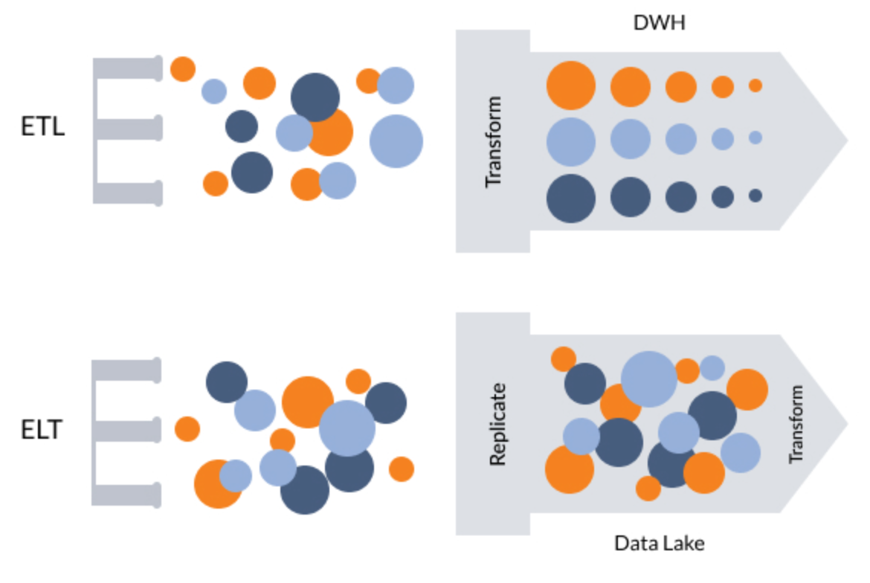
Data Warehouse vs Data Lake
Data warehouse
= DB storing data from different systems in a structured way
E.g., a large Postgres instance with many DBs and tables
Data lake
= data stored in a semi-structured or without structure
E.g., an AWS S3 bucket storing blog posts, flat files, JSON objects, images

Slide 44
Data Lake: Pros and Cons
Data lake = stores data in a semi-structured or without structure
Pros:
Storing data in cloud storage is cheaper
Making changes to types or properties is easier since it's unstructured or semi-structured (with no predefined schema)
E.g., JSON documents
Data scientists
Don't know initially which data to use and how to access the data
Want to explore the raw data
Cons:
It is not optimized for querying like a structured data warehouse
There are tools that allow to query data in a data lake similar to SQL
E.g., AWS Athena, Redshift Spectrum

Slide 45
Advantages of Cloud Computing
Ease of building and deploying:
Data pipelines
Data warehouses
Data lakes
Managed services
No need for admin and deploy
Highly scalable DBs
E.g., Amazon Redshift, Google BigQuery, Snowflake
Rent-vs-buy
Easy to scale up and out
Easy to upgrade
Better cash-flow
Cost of storage and compute is continuously dropping
Economy of scale
The flexibility has a cost (2x-3x more expensive than owning)
Vendor lock-in

Slide 46
ETL Paradigm
Extract
Gather data from various data sources, e.g.,
external data warehouse
REST API
data downloading
web scraping
Transform
Raw data is combined and formatted to become useful for analysis step
Load
Move data into the final destination, e.g.,
Data warehouse
Data lake
Data ingestion = E + L
Move data from one point to another
Format the data
Make a copy
Have different tools to operate on the data

Slide 47
ETL Paradigm
Data ingestion tools
Buy-vs-build
Vendor lock-in
Data transformation, e.g.,
Data conversion (e.g., parsing timestamp)
Create new metrics from multiple source columns
Aggregate / filter through business logic
Anonymize data
Data modeling
Structure data in a format optimized for data analysis
E.g., load data in relational DB

Slide 48
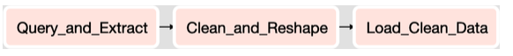
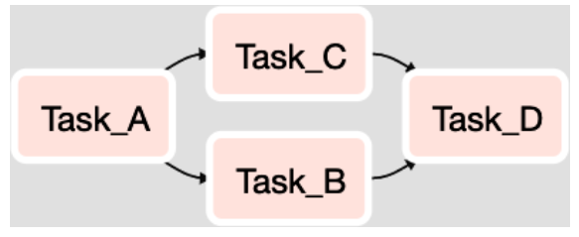
Workflow Orchestration
Companies have many 10-1000s data pipelines
Schedule and manage flow of tasks according to their dependencies
Pipeline and jobs are represented through DAGs
Monitor and send alarm
Orchestration tools, e.g.,
Apache Airflow
Luigi
AWS Glue
Kubeflow

Slide 49
ELT paradigm
ETL has been the standard approach for long time
Extract -> Transform -> Load
Today ELT is becoming the pattern of choice
Extract -> Load -> Transform
Enabled by cloud computing
Large storage to save all the raw data
Distributed data storage and querying (e.g., HDFS)
Columnar DBs
Data compression
Allow to separate data engineers and data scientists / analysts
Data engineers focus on data ingestion (E + L)
Data scientists focus on transform (e.g., SQL, MongoDB)
No need to know how the data will be used
ETL requires to understand the data at ingestion time

Slide 50
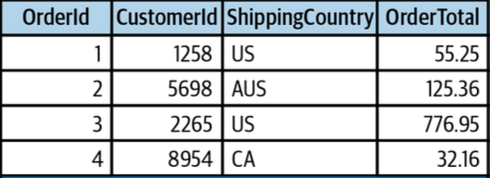
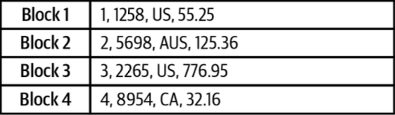
Row-based vs Columnar DBs
Row-based DBs
E.g., MySQL, Postgres
Optimized for reading / writing records
Read / write small amounts of data frequently
Columnar DBs
E.g., Amazon Redshift, Snowflake
Read / write large amounts of data infrequently
Analytics requires a few columns

Slide 51
EtLT
ETL
Extract -> Transform -> Load
ELT
Extract -> Load -> Transform
Transformations / data modeling (“T”) according to business logic
EtLT
Sometimes transformations with limited scope (“t”) are needed
De-duplicate records
Parse URLs into individual components
Obfuscate sensitive data (for legal or security reasons)
Then implement rest of “LT” pipeline

